Slide 1
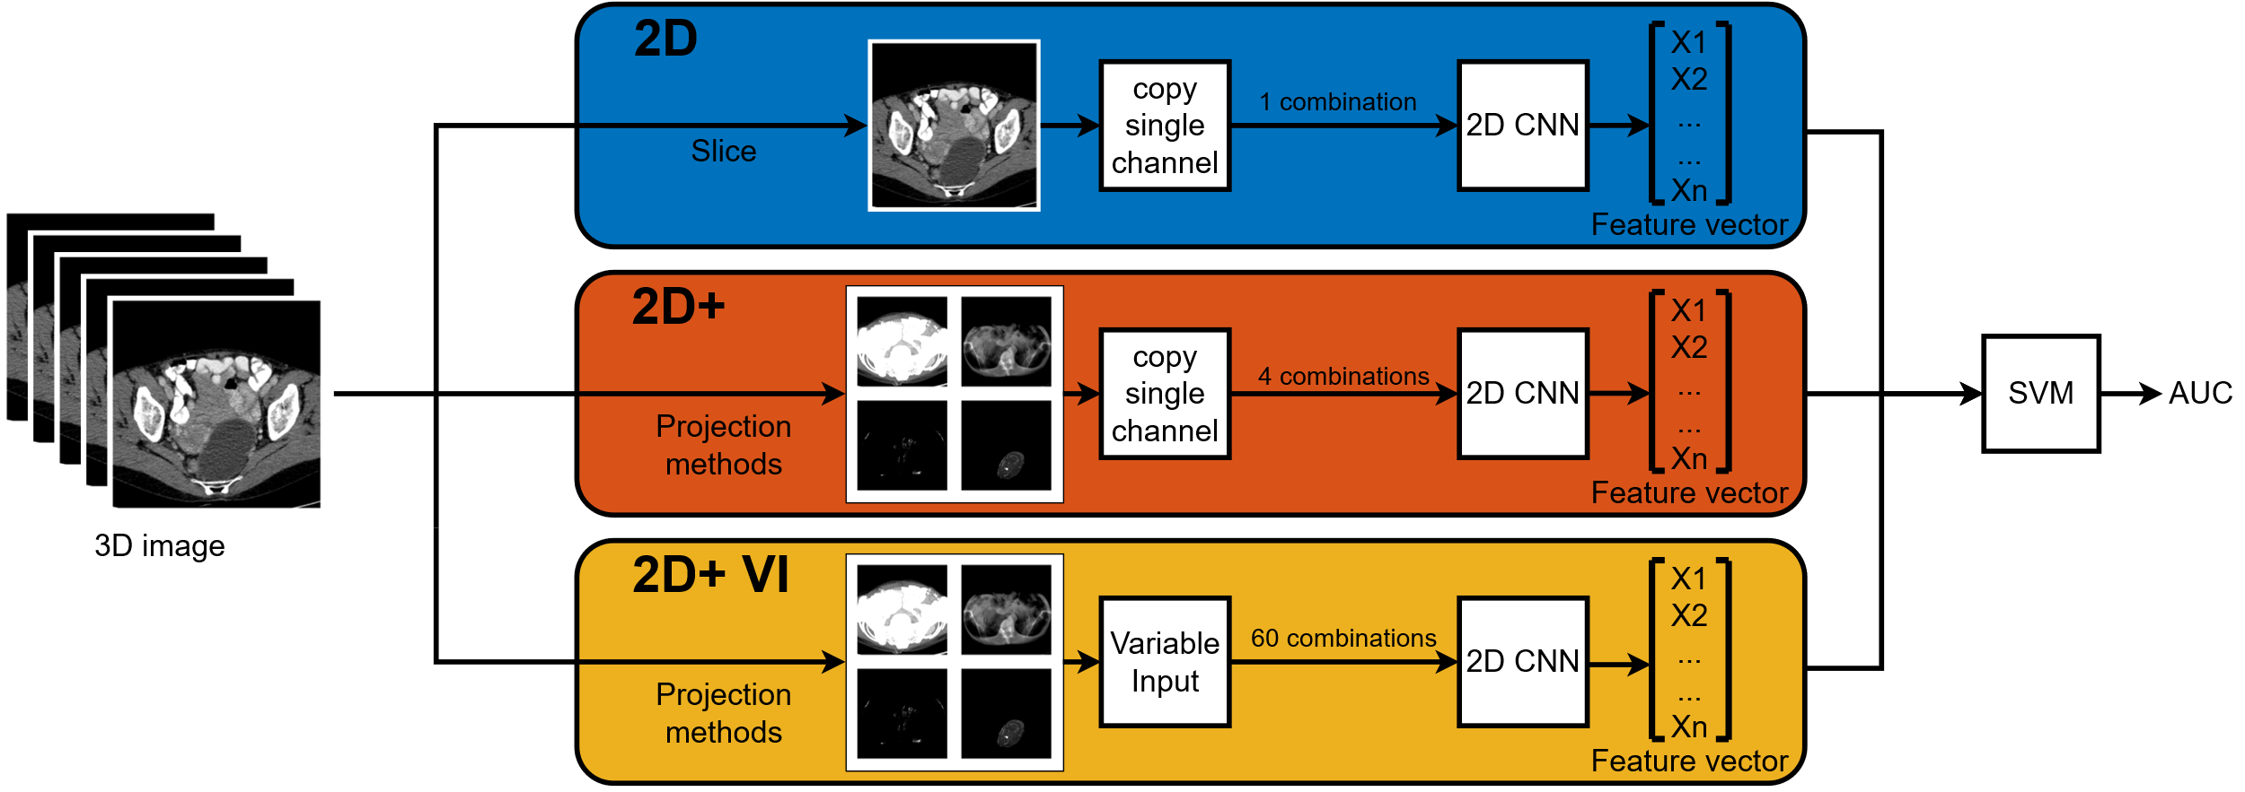
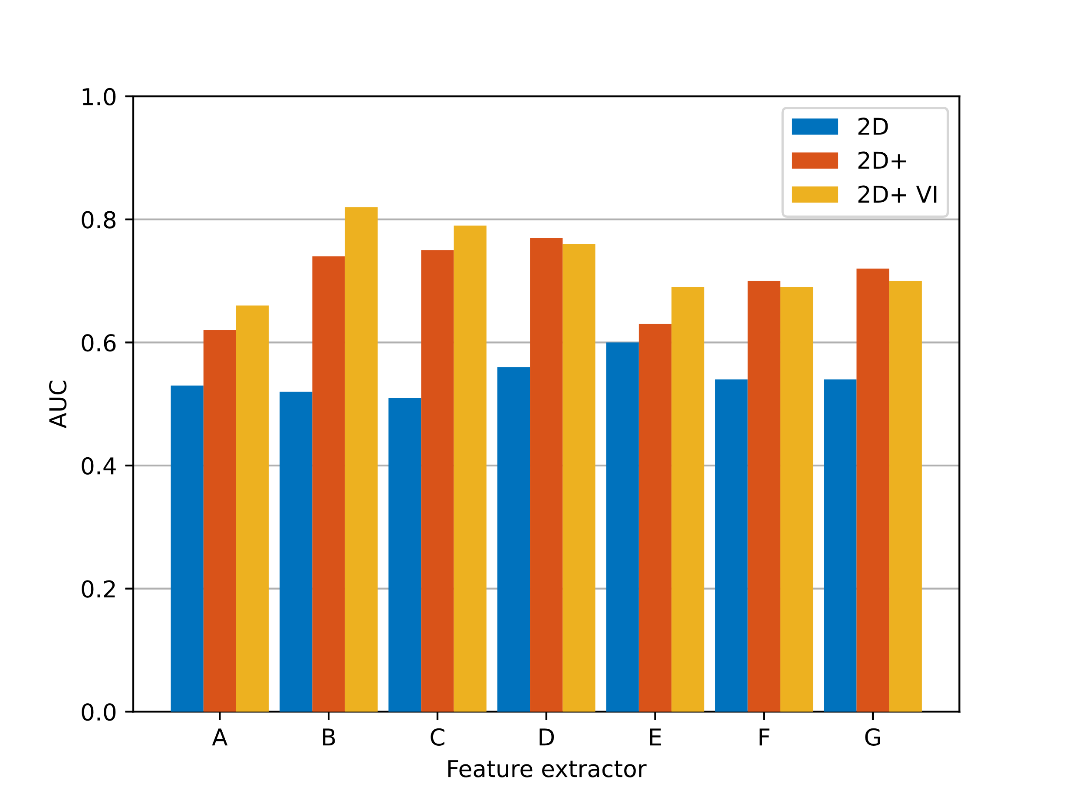
Improving 2D CNN based feature extraction of 3D CT scan images for ovarian cancer
Sven Bierenbroodspot, s.a.k.Bierenbroodspot@student.tue.nl
Conclusion
Explored methods improve performance considerably

